Slide 1
Agile Presentation
Joseph Eaton
8/24/2024

Slide 2
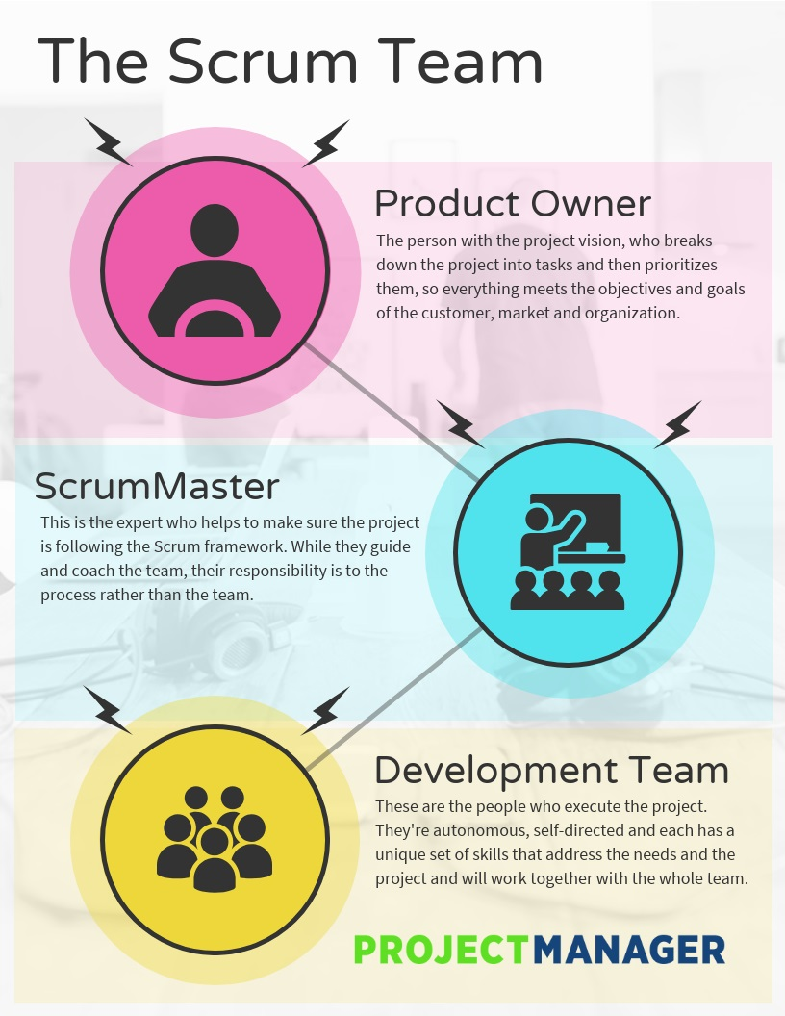
Agile Roles
Product Owner: Manages the product roadmap, creates and organizes the backlog for the project and creates the user stories from end users and focus groups.
Scrum Master: Facilitates the scrum meetings to ensure the team can communicate also acts as a middleman between the rest of the team and Product Owner. Acts as a guide for the rest of the team to keep the project on track for completion.
Tester: The Tester works hand and hand with the Developer to ensure all of the work being done to incorporate the user stories works as functioned by creating test cases. They ensure the program works as intended.
Developer: The Developer is responsible for programming and incorporating the User Stories into the final project by communicating with the Product Owner to ensure all the requirements are met.
Landau, P. (2023, July 10). Scrum Team Roles: A Quick Guide. Project Manager. https://www.projectmanager.com/blog/scrum-roles-the-anatomy-of-a-scrum-team

Slide 3
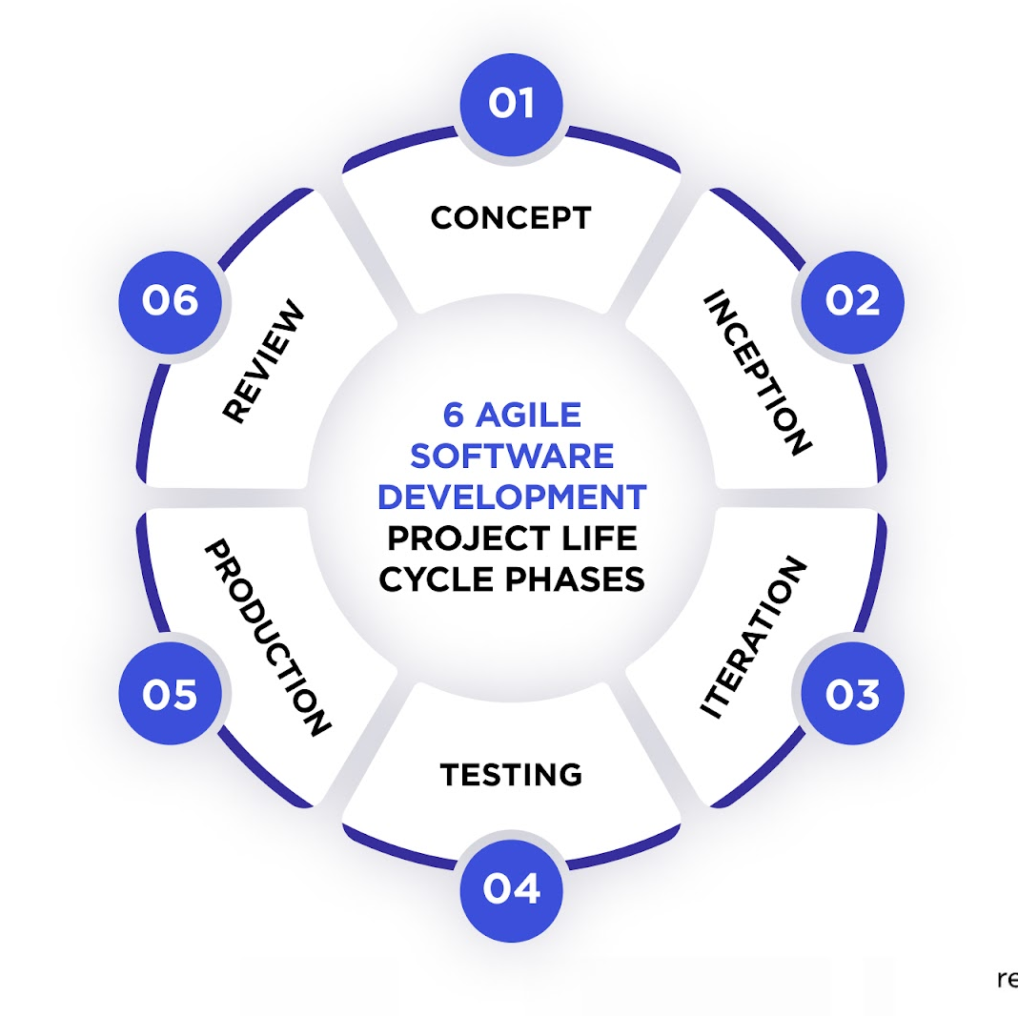
Agile Phases
Concept
The start of the cycle where stakeholders and product owners create an outline for the project's priorities.
Inception
Where the team gets selected, and roles become appointed, and a plan gets formed for the completion of the project
Iteration
The phase where the developers ensure that all the feedback and needs are incorporated into the product as they work through the back log to add additional items to the end product.
Testing
This phase tester will go through to ensure the needs of the user stories have been met and that the code is functioning correctly
Release
This is the phase where the public finally gets to have the finished product after all the testing and necessary changes have been made and or added.
Review
This is where we take the time as a team and review the launch and strive for Longterm success in the development of the program .

Slide 4

Waterfall Model
When looking at the waterfall method a way it is described in The Project Manager's Guide to Mastering Agile "the waterfall model describes a development method that is linear and sequential"(Cobb, 2015, p. 4). The term is used since once the water is to go over the cliff the journey has begun and there is no going backwards. This would change development since once a phase of the team's development was finished there would be no turning back. This would've caused an issue at the end when the team was asked to change to a different type of vacation type as the focus as our previous developments would've already been finished. Since it is more plan driven it struggles to accommodate sudden changes in those plans by the end of the project.

Slide 5

Waterfall or Agile Approach
When looking at Waterfall or Agile Approach when considering what to choose it depends on the needs of the project. If a project is expected to go through multiple changes through the development, then agile would be the go along with the Timeline typically the Waterfall approach has a fixed timeline. With agile "Rather than a fixed timeline, the schedule adapts as the project progresses." (Hoory, 2024 P.2) The big thing to consider is whether the project has strict requirements and regulations which would lead for waterfall method to be better to ensure all is completed. Agile is better suited for projects that incorporate a lot of changes throughout the development cycle from feedback from stake holders and end-users.

Slide 6
Work Cited
Charles G. Cobb. (2015). The Project Manager’s Guide to Mastering Agile : Principles and Practices for an Adaptive Approach. Wiley.
Hoory, L. (2024, June 1). Agile vs. waterfall: Which project management methodology is best for you?. Forbes. https://www.forbes.com/advisor/business/agile-vs-waterfall-methodology/
Dizuba, A. (2024, June 7). Navigating the agile software development life cycle: Phases, tools, roadmap. Relevant Software. https://relevant.software/blog/agile-software-development-lifecycle-phases-explained/#Phase_1_Concept
SDLC - Agile Model. Tutorialspoint. (n.d.). https://www.tutorialspoint.com/sdlc/sdlc_agile_model.htm

